Slide 1
Real Time Face Detection and Face Recognition using OpenCV and Python

Slide 2
Chapters
1. INTRODUCTION TO IMAGE PROCESSING
2. FACE DETECTION
3.RELATED WORK
4.PROPOSED FRAMEWORK
5. SOFTWARE USED
6. SIMULATION RESULTS
7. SAMPLE CODING
8. CONCLUSION & FUTURE WORK
9 REFERENCES

Slide 3
CHAPTER - 1
INTRODUCTION TO IMAGE PROCESSING
Images and pictures
The human beings are predominantly visual creatures: we rely heavily on our vision to make sense of the world around us. We not only look at things to identify and classify them, but we can scan for differences, and obtain an overall rough―feeling for a scene with a quick glance. Humans have evolved very precise visual skills: we can identify a face in an instant; we can differentiate colors; we can process a large amount of visual information very quickly .
What is image processing?
Image processing involves changing the nature of an image in order to either
1. Improve its pictorial information for human interpretation
2. Render it more suitable for autonomous machine perception.

Slide 4
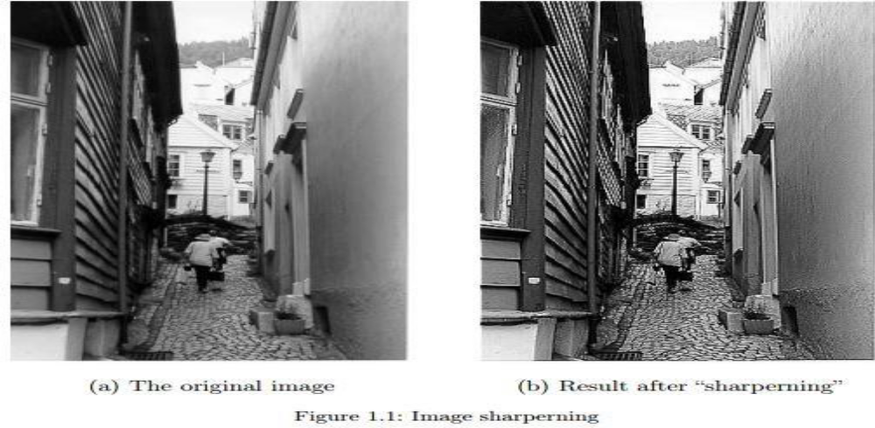

Slide 5
Images and digital images
Suppose we take an image, a photo, say. For the moment, let’s make things easy and suppose the photo is black and white (that is, lots of shades of grey), so no color. We may consider this image as being a two-dimensional function, where the function values give the brightness of the image at any given point. We may assume that in such an image brightness values can be any real numbers in the range 0(black) to 1 (white).
Some applications
1.Medicine Inspection and interpretation of images obtained from X-rays, MRI or CAT scans, analysis of cell images, of chromosome karyotypes.
2. Agriculture Satellite/aerial views of land, for example to determine how much land is being used for different purposes, or to investigate the suitability of different regions for different crops, inspection of fruit and vegetables—distinguishing good and fresh produce from old.
3. Industry Automatic inspection of items on a production line, inspection of paper samples.
4. Law enforcement Fingerprint analysis, sharpening or de-blurring of speed-camera images.

Slide 6
Aspects of image processing
Image enhancement
This refers to processing an image so that the result is more suitable for a particular application.
Image restoration
This may be considered as reversing the damage done to an image by a known cause, for example: removing of blur caused by linear motion
Image segmentation
This involves subdividing an image into constituent parts, or isolating certain aspects of an image

Slide 7
An image processing task
Acquiring the image
Preprocessing
Segmentation
Representation and description
Recognition and interpretation

Slide 8
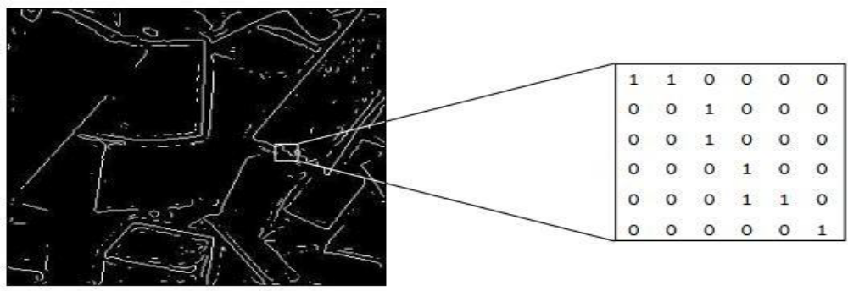
Types of digital images
Binary
Each pixel is just black or white.

Slide 9
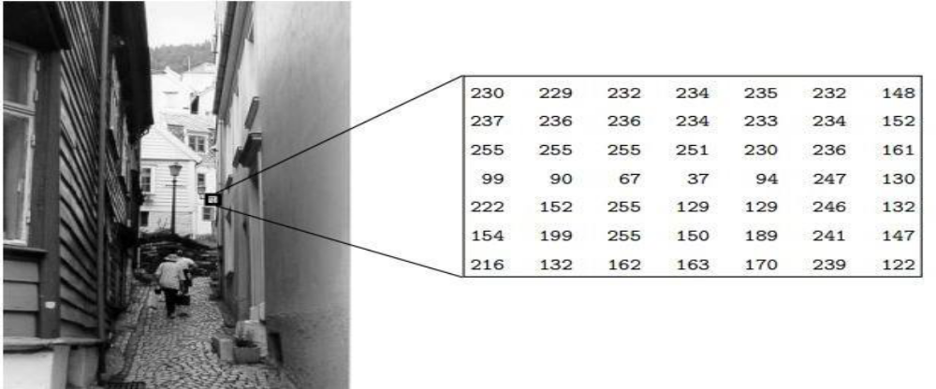
Greyscale
In grayscale image (fig 1.3) Each pixel is a shade of grey, normally from 0(black) to255 (white).

Slide 10
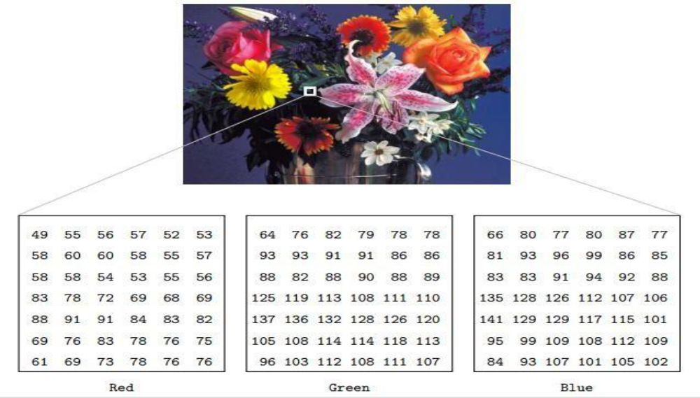
True colour or RGB
In RGB image Here each pixel has a particular colour; that colour being described by the amount of red, green and blue in it.

Slide 11
Image Acquisition
CCD camera
Such a camera has, in place of the usual film, an array of photo sites; these are silicon electronic devices whose voltage output is proportional to the intensity of light falling on them. For a camera attached to a computer, information from the photo sites is then output to a suitable storage medium.
Flatbed scanner
This works on a principle similar to the CCD camera. Instead of the entire image being captured at once on a large array, a single row of photo sites is moved across the image, capturing it row-by-row as it moves.
Image perception
Much of image processing is concerned with making an image appear better to human beings. We should therefore be aware of the limitations of the human visual system. Image perception consists of two basic steps:
1. Capturing the image with the eye,
2. Recognizing and interpreting the image with the visual cortex in the brain.

Slide 12
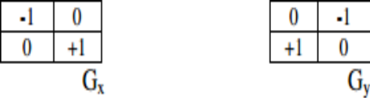
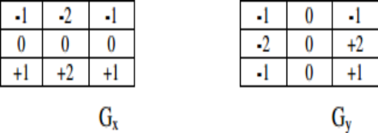
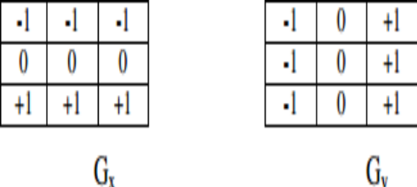
EDGE DETECTION TECHNIQUES
Roberts Edge Detection:
Sobel Edge Detection
Prewitt Edge Detectio

Slide 13
Canny Edge Detection
Convolve image f(r, c) with a Gaussian function to get smooth image f^(r, c). f^(=f(r,c)*G(r,c,6)
Apply first difference gradient operator to compute edge strength then edge magnitude and direction are obtain as before.
Apply non-maximal or critical suppression to the gradient magnitude.
• Apply threshold to the non-maximal suppression image. Unlike Roberts and Sobel, the Canny operation is not very susceptible to noise. If the Canny detector worked well it would be superior.

Slide 14
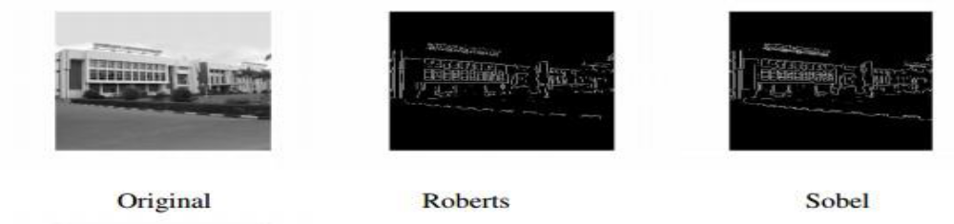
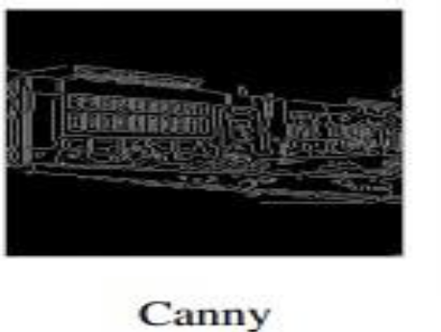
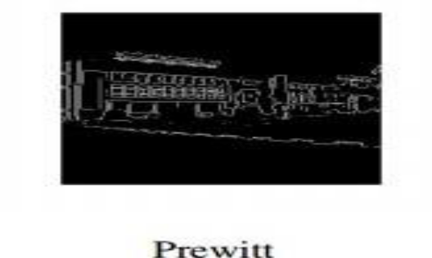

Slide 15
CHAPTER-2 FACE DETECTION
Face detection also called facial detection is an artificial intelligence (AI) based computer technology used to find and identify human faces in digital images. Face detection technology can be applied to various fields including security, biometrics, law enforcement, entertainment and personal safety to provide surveillance and tracking of people in real time.
How face detection works?
Face detection applications use algorithms and ML to find human faces within larger images, which often incorporate other non-face objects such as landscapes, buildings and other human body parts like feet or hands. Face detection algorithms typically start by searching for human eyes one of the easiest features to detect. The algorithm might then attempt to detect eyebrows, the mouth, nose, nostrils and the iris. Once the algorithm concludes that it has found a facial region, it applies additional tests to confirm that it has, in fact, detected a face.

Slide 16
Advantages of face detection
As a key element in facial imaging applications, such as facial recognition and face analysis, face detection creates various advantages for users, including:
• Improved security. Face detection improves surveillance efforts and helps track down criminals and terrorists.
• Easy to integrate.
• Automated identification.

Slide 17
Disadvantages of face detection
While face detection provides several large benefits to users, it also holds various disadvantages, including:
• Massive data storage burden. The ML technology used in face detection requires powerful data storage that may not be available to all users.
• Detection is vulnerable. While face detection provides more accurate results than manual identification processes, it can also be more easily thrown off by changes in appearance or camera angles.
• A potential breach of privacy. Face detection's ability to help the government track down criminals creates huge benefits; however, the same surveillance can allow the government to observe private citizens. Strict regulations must be set to ensure the technology is used fairly and in compliance with human privacy rights.

Slide 18
Face detection vs. face recognition
Although the terms face detection and face recognition are often used together, facial recognition is only one application for face detection -albeit one of the most significant ones. Facial recognition is used for unlocking phones and mobile apps as well as for Biometric verification. The banking, retail and transportation-security industries employ facial recognition to reduce crime and prevent violence.
In short, the term face recognition extends beyond detecting the presence of a human face to determine whose face it is. The process uses a computer application that captures a digital image of an individual's face sometimes taken from a video frame and compares it to images in a database of stored records.

Slide 19
CHAPTER-3 RELATED WORK
Object detection has been a great challenge from the past few years. In computer vision human face detection is an important research topic. It is needed for many computer applications like HCI, surveillance, human-robot interaction, etc. In this field facial tracking is finding more growth of use in security and safety applications to detect various situations. This tracking domain can be used to control or communicate with robots. Detecting human faces in a video is a great challenging problem. These configurations may be like angle of view, background intensity, and various illuminations. This is due to high variety of configurations that may occur. The complexness of the face results in a particular degree of issue for fast detection and tracking [2]. For face detection and tracking in a given video sequence different algorithms have been introduced over the past few years. Each algorithm has got its own advantages and disadvantages. But any face tracking algorithm will have some errors which will cause deviation from the required object

Slide 20
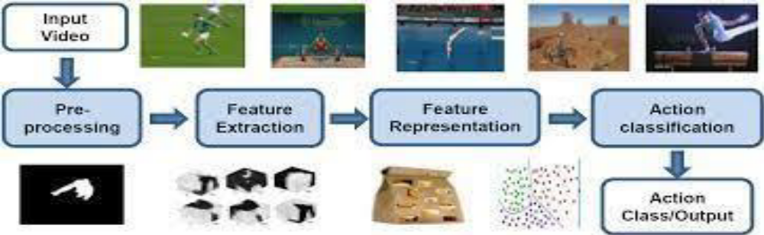
Literature Review
Md. A.R. Ahad proposed a classifier in Computer vision and action recognition: A guide for image processing and computer vision community for action understanding [Reference] where the features of the images are classified to different groups [3]

Slide 21
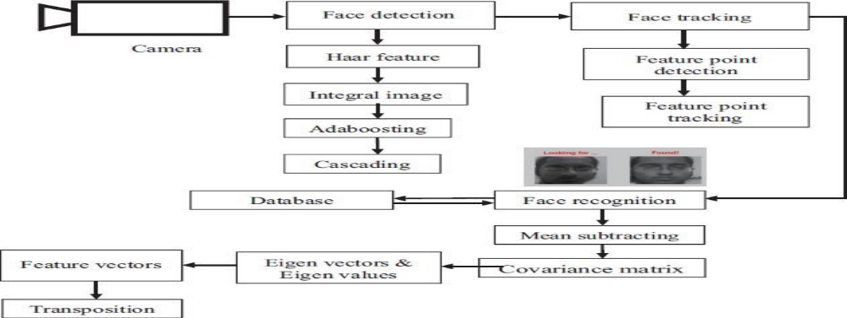
Face tracking
Object tracking is defined as keeping a trace on a particular kind of object. In this project as we are mainly concentrating on face, we track human faces based on the given input features.

Slide 22
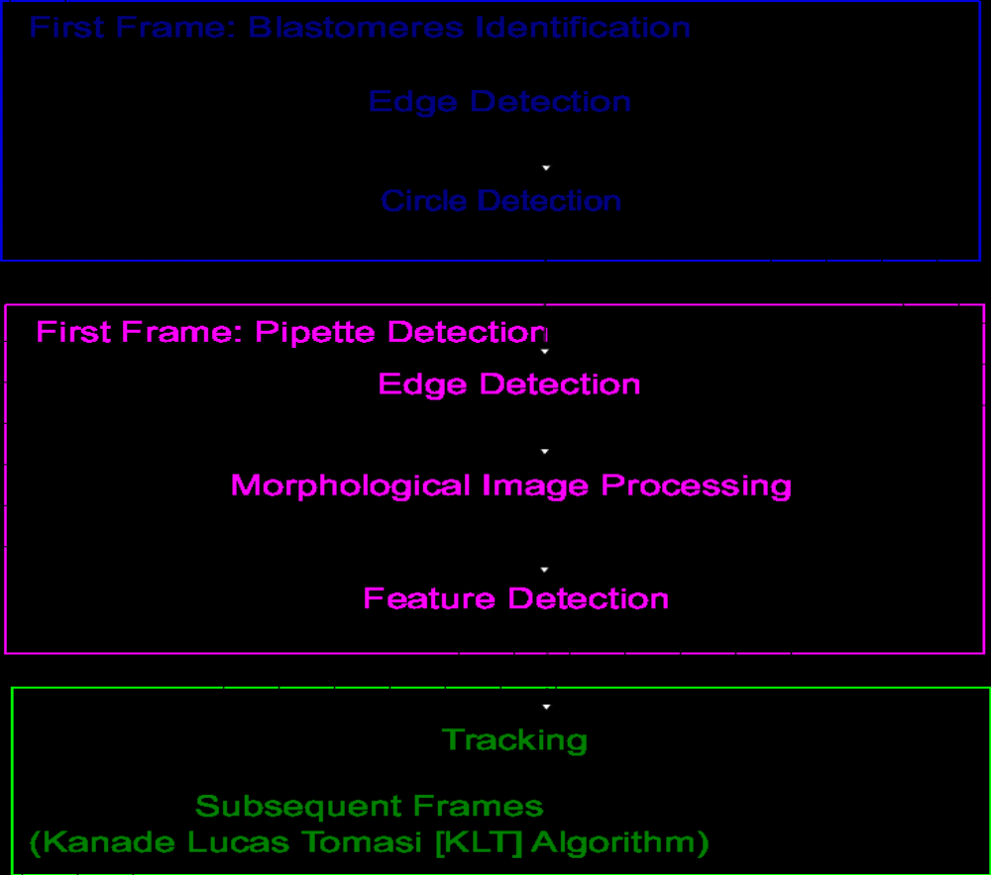
Kanade Lucas Tomasi (KLT) algorithm

Slide 23
Viola Jones algorithm
This algorithm helps us detect features of a face in a particular frame of a video sequence. This is the first object detection framework which gives a competition to real time detection rates. Paul Viola and Michael Jones are the ones who introduced this algorithm. They made this algorithm mainly by the issue of face detection. There are four steps which have to be followed to detect a face. Firstly, we train the system with the haar features [12-14]. Haar features are a kind of rectangular boxes which are black and white. Haar features are simple rectangular feature which is the difference of the sum of pixels of areas inside the rectangle. This rectangle can be at any position of the frame and can scale the image. This modified feature set is called 2-rectangle feature

Slide 24
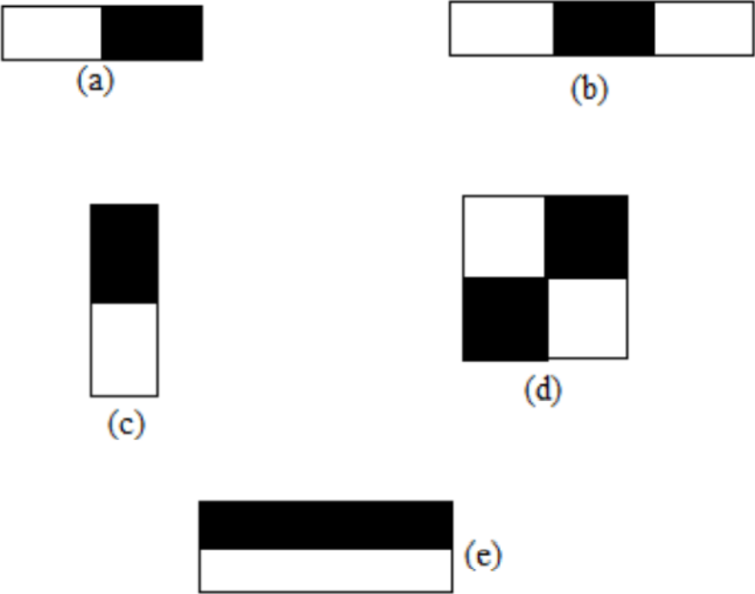
Viola Jones algorithm

Slide 25
CHAPTER-4 PROPOSED FRAMEWORK
One of the most challenging tasks in the field of artificial intelligence is computer vision. This process involves connecting the various parts of a computer software to the visual representations we see around us.Through computer vision, software can learn about the visual representations in its environment. For instance, by determining the size and color of a fruit, its shape and appearance the type of fruit and its quality can be classified. The goal of computer vision is to provide a more accurate and useful information to humans. It can also help us identify and understand the various elements of the visual representations around us[1][2]. The term "openCV" refers to an open-source framework that enables the development of computer vision applications. It includes various software components and plugins that can be used to integrate these applications[3]. The openCV framework has been released several times. It is free and open-source, and it can be used for various tasks such as numerical productivity.

Slide 26
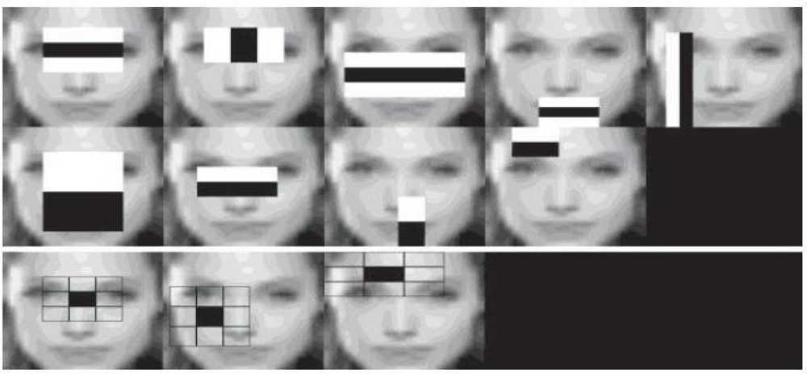
Haar Cascade
The Haar Cascade method [3] is a machine-learning technique that can be used to detect objects. It learns from a series of images that have positive and negative characteristics. The Haar cascade method can be used to see objects in different frames. In the first image, the Haar cascade classifier shows the view of its operation.

Slide 27
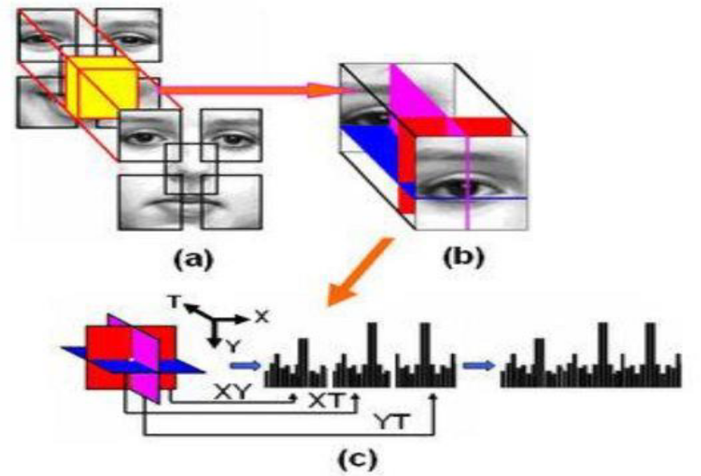
Local Binary Pattern
A local binary pattern (LBP) is a simple technique that labels images by region and number. It can be used to treat the resulting image as a binary number. Due to its computational simplicity and discriminative power, the LBP has become a popular technique for creating various image labels.

Slide 28
Eigen Faces
In order to minimize the dimensionality of the images, the LBP is used to perform a Principal Component Analysis (PCA)[a] on the distribution of facial images. The goal of this process is to find the best possible vectors for each facial expression. The eigenvalue distribution is used to calculate the principal component amount of a facial image. This process is performed by taking into account the covariance matrix's eigenvalue and m eigenvector.
Fisher Faces
Face recognition has been a promising tool for researchers to identify people accurately. The Fisher Face model [b] combines the PCA and FLD[c] calculation models to perform a face recognition computation.

Slide 29
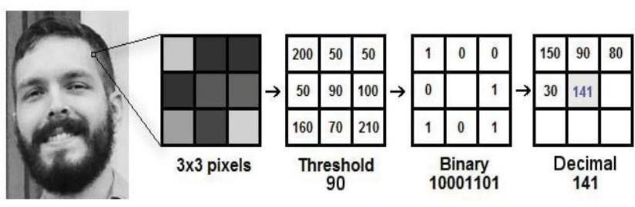
LBPH
The LBP texture operator is a widely used technique in various applications, such as facial recognition. It takes into account the various outcomes of a given binary number by comparing the values of the center and the neighboring pixels. This technique was first identified in 1994. Since then, the LBP algorithm has evolved into a more accurate and efficient method for classification of textures.

Slide 30
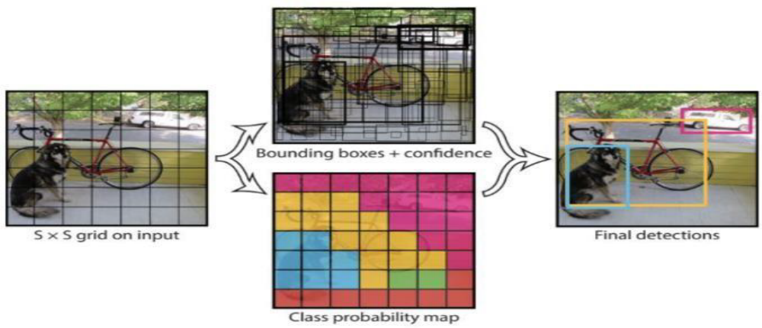
YOLO
The Yolo system [4.2] is a real-time object detection system which only works once. It takes advantage of a single neural network to process an image[16]. The network then breaks the image into sections and estimates the probabilities of each box

Slide 31
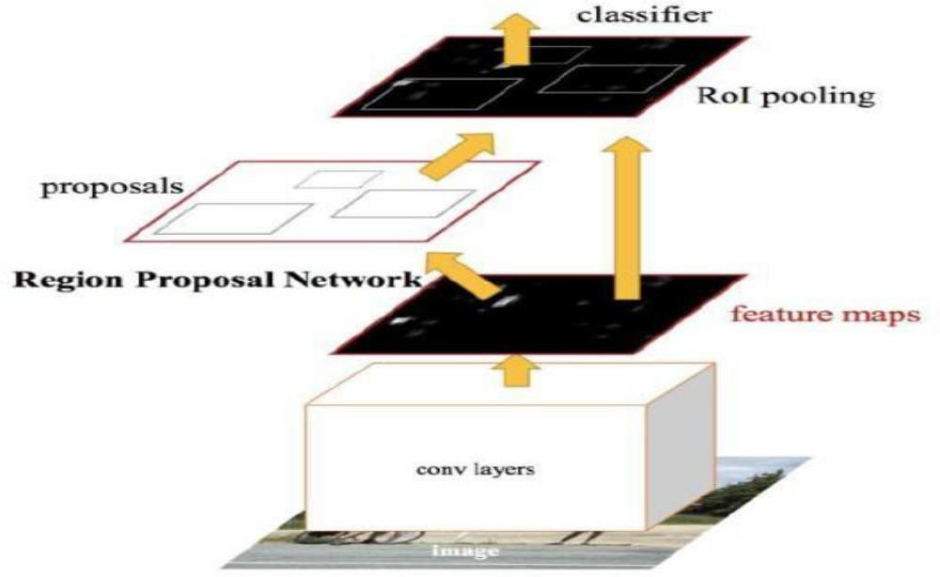
Single Shot Detectors (SSDs)
The feed-forward single shot detector (SSD) is a method that generates a border-box array consisting of class-based entity instances in a set of boxes. It then generates a final detection by preserving the original image classification design[16][20].

Slide 32
CHAPTER-5 SOFTWARE USED
Main Modules
Main modules are the main components of OpenCV and are included in the package versions by necessity. They are called core modules since they include essential functions, including image recognition, filtering, and transformation
Extra Modules
Extra modules are not included in the OpenCV release by default. Additional machine vision functionalities, such as text detection, are applied to these modules [21].
The main modules are described below:
Core: Have most of OpenCV's core features.
Imgproc: Picture processing tools such as transforms, manipulations, and filtering are used.
Imgcodecs: Image reading/writing features are included.
Videoio: Video reading/writing features are included.

Slide 33
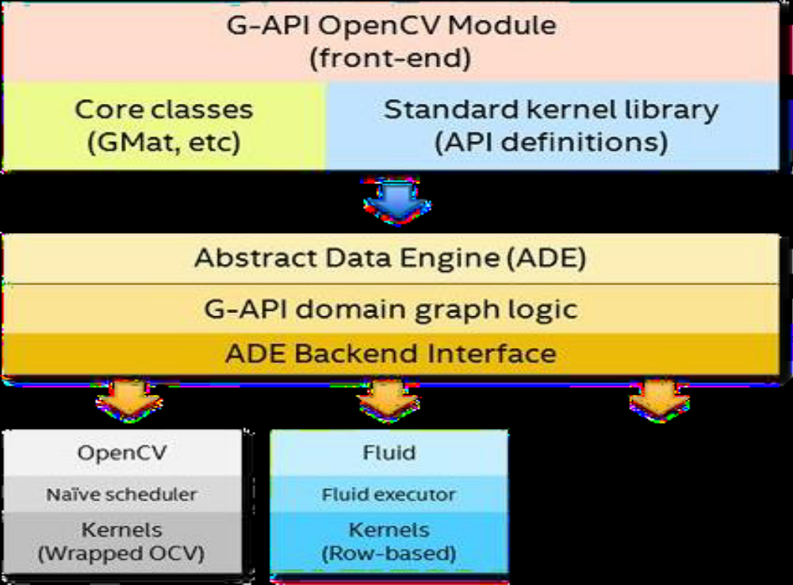

Slide 34
OpenCV based on Python
Guido van Rossum created the Python programming language to make it easy to understand. He wanted to reduce the number of characters in the code to make it easier for the programmer to communicate. Compared to other programming languages, such as C/C++, Python is slower. However, it can be used to expand the capabilities of C/C++. Also, Python is very flexible. The C++ function that adds a function to the output of a program helps in the implementation of C++ code. This can be used to create various modules in Python. One of the main advantages of using Python is that it is as fast as C++. Also, it is very easy to program in. Through the use of the open CV function, you can also create various applications that are easy to implement. The implementation of Python is built on top of the C++ code. Also, the contributions of the other libraries, such as the numpy, help in the development of high-level statistical applications. In addition to the C++ code, the implementation of Python also takes advantage of the various features of the openCV function. It can convert various OpenCV structures into the appropriate Numpy arrays. This is very good because it makes it easier to implement various functions in the same package

Slide 35
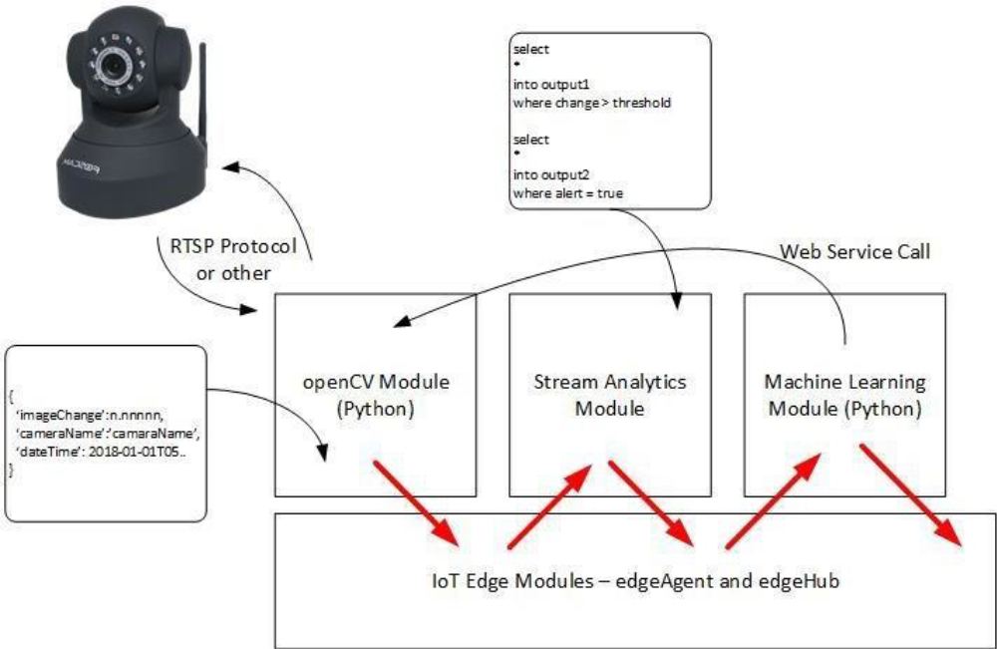

Slide 36
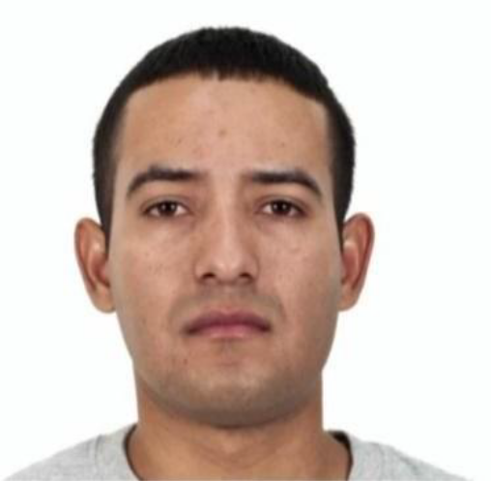
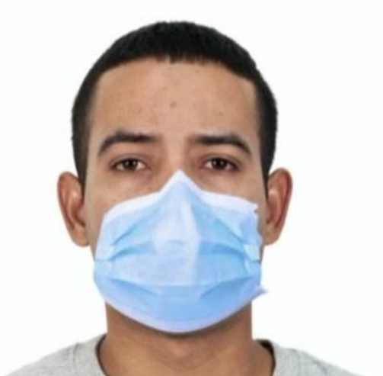
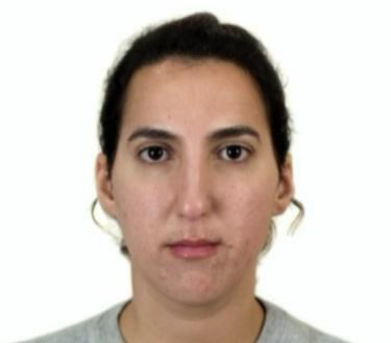
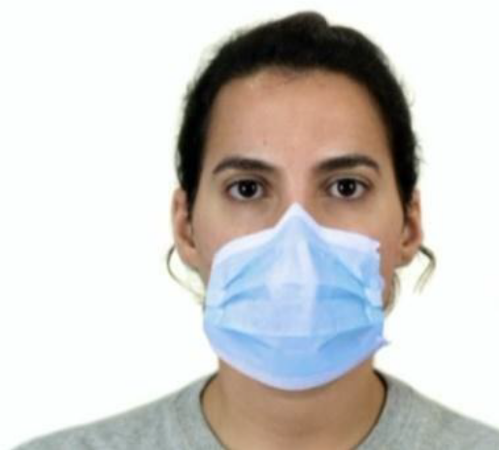
CHAPTER-6 SIMULATION RESULTS
The proposed framework is executed using OpenCV software and the following figures show the images taken for the verification purpose.

Slide 37
CHAPTER-7
SAMPLE CODING
# coding: utf-8
# # Face Detection In Python Using OpenCV
# ## OpenCV
# OpenCV is an open source computer vision and machine learning software library. It is a BSD-licence product thus
# free for both business and academic purposes.The Library provides more than 2500 algorithms that include machine
# learning tools for classification and clustering, image processing and vision algorithm, basic algorithms and
# drawing functions, GUI and I/O functions for images and videos. Some applications of these algorithms include face
# detection, object recognition, extracting 3D models, image processing, camera calibration, motion analysis etc.
# OpenCV is written natively in C/C++. It has C++, C, Python and Java interfaces and supports Windows, Linux, Mac OS,

Slide 38
The algorithm has four stages:
1. *Haar Feature Selection:*
2.Creating an Integral Image
3. Adaboost
4.Cascading Classifiers

Slide 39
CHAPTER-8
CONCLUSION & FUTURE WORK
Computer Vision is a field of artificial intelligence that focuses on the processing of images and videos. It involves developing computers that can extract the most important details from the images. The OpenCV library, which is a C++based open-source project, provides various functions for developing computer vision applications. Some of these include object detection, facial recognition, and medical diagnosis. In this work, we discuss the various functions of OpenCV in face recognition and object detection. We show how the library can be used to develop effective face recognition and object detection algorithms. We then introduce the OpenCV modules and their applications, and we discuss the various literature reviews that have been published about the library. We then conclude by talking about the human face that can be recognized using the OpenCV platform.

Slide 40
REFERENCES
[1] Jagtap, A. M., Kangale, V., Unune, K., &Gosavi, P. (2019, February). A Study of LBPH, Eigenface, Fisherface and Haar-like features for Face recognition using OpenCV. In 2019 International Conference on Intelligent Sustainable Systems (ICISS) (pp. 219-224). IEEE
[2] Sigut, J., Castro, M., Arnay, R., &Sigut, M. (2020). OpenCV basics: a mobile application to support the teaching of computer vision concepts. IEEE Transactions on Education, 63(4), 328-335
[3] Adusumalli, H., Kalyani, D., Sri, R. K., Pratapteja, M., & Rao, P. P. (2021, February). Face Mask Detection Using OpenCV. In 2021 Third International Conference on Intelligent Communication Technologies and Virtual Mobile Networks (ICICV) (pp. 1304-1309). IEEE
[4] Mostafa, S. A., Mustapha, A., Gunasekaran, S. S., Ahmad, M. S., Mohammed, M. A., Parwekar, P., &Kadry, S. (2021). An agent architecture for autonomous UAV flight control in object classification and recognition missions. Soft Computing, 1-14

